Slide 1
Machine Learning for ESGF
This work was performed under the auspices of the U.S. Department of Energy by Lawrence
Livermore National Laboratory under Contract DEAC52-07NA27344.
LLNL-PRES-884177
Task |  | R&D Area
1.1 |  | Data Management
1.2 |  | User Interface and Search
1.3 |  | Hardware & Network
1.4 |  | Data Transfer
1.5 |  | Installation (Containerized)
1.6 |  | Authentication & Authorization
1.7 |  | Federation
1.8 |  | Quality Control & Assurance
1.9 |  | Replication
1.10 |  | Distributed Search
1.11 |  | Metrics
1.12 |  | User Notification
1.13 |  | Long-tail Publication
1.14 |  | Distributed Computation
1.15 |  | Data Citation
2.1 |  | Provenance Capture
2.2 |  | Workflow
2.3 |  | Dynamic Resources
2.4 |  | In situ Analysis
2.5 |  | Machine Learning
2.6 |  | UQ
2.7 |  | Analytical Modeling
2.8 |  | Mobile Apps
Current capability status:
 | Usable
 | Prototype
 | Research activity
Sookyung Kim, Ph.D.
Lawrence Livermore National Laboratory
2017 Triennial Project Review, Potomac, MD
June 8 – 9, 2017
This work performed under the auspices of the U.S. Department of Energy by Lawrence Livermore National Laboratory under Contract DE-AC52-07NA27344
Notes:
Hello Everyone. My name is sookyung Kim, post-doc in LLNL.
Today, I will talk about Machine Learning application for ESGF

Slide 2
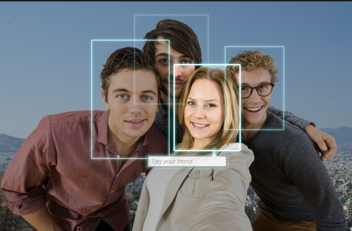
Notes:
How many of you use facebook? How many of you use iphone.
If you have used product such as facebook, iphone and google translator, you may have used the automatic face recognition in facebook, siri in iphone and google translator.
The underline technologies below them is “deep learning”.
Deep learning is changing the world.

Slide 3
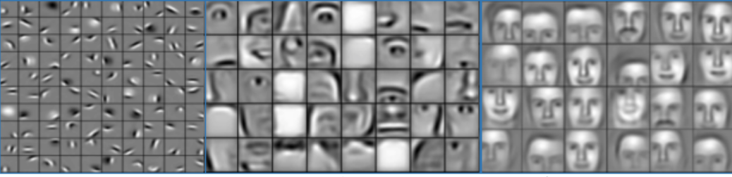
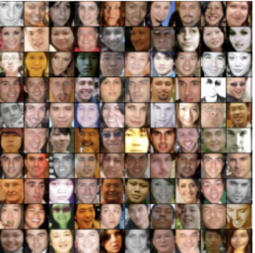
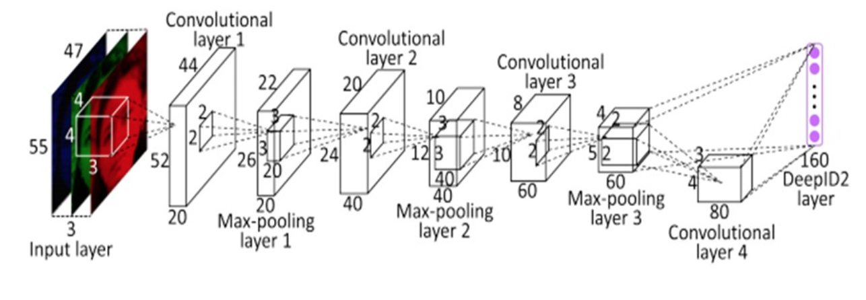
Deep Neural Network
Deep convolutional neural networks (CNNs) learn hierarchical feature representation
Error Backpropagation
Notes:
Deep learning is the method to learn underline pattern in massive scaled data using deep neural network.
The idea is simple.
Let’s consider face recognition task. When you see the people’s face in image, how can you recognize who he or she is?
First, you will try to find small part, such as eye, nose and mouth.
Then, you will see the bigger picture, and find bigger part, such as region around eyes, nose and so on..
Then, finally, you will see the whole face and judge who he or she is.
Deep learning do exactly same task like what people do, using many layered convolutional neural network.
By passing massive data of people’s face to multiple convolutional layers, it try to optimize filter to detect people’s face.
Those filters are combinrd and capture hierarchical patterns layer by layer.
So, in first layer, it optimize filter to detect small patterns, such as eyes, noses and so on.
Those small patterns combine together, then make the filter to detect bigger part in next layer..
And, at the last layer , it detect whole face of people.
In this way, we can capture the important latent pattern in large scaled data.

Slide 4

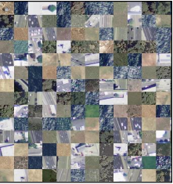
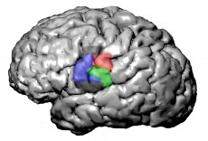



Deep Learning enable Science
Classify satellite images for carbon monitoring
Analyze recording of human brain
Analyze obituaries for
Cancer-related disease.
Notes:
Many government laboratories and scientific communities are started to use DL to analyize their scientific data.
For example, in NASA, DL is used to classify satellite images.
In Berkeley Lab, DL is used to analyze recording of human brain.
In Oak ridge lab, DL is used to analyze obituaries for cancer-related disease.

Slide 5
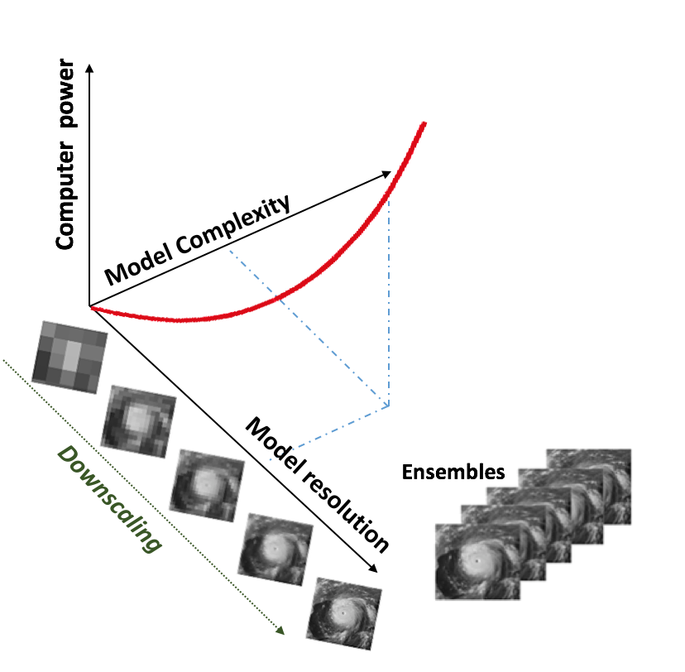
Motivation
Only way to analyze Peta scaled data in ESGF
Let CNNs learn feature representation of extreme climate events in GCM outputs
Ultimately save computing cost for Numerical Weather Predictions
Numerical weather prediction is an ”Expensive” process!
256 million grid points
Data-Driven Approach?
GCM
RCM
Notes:
This DL techniques opens tremendous research opportunities using peta scaled climate and geoscience data in ESGF, which we couldn’t even imagined before.
One example is detecting extreme climate event.
Conventional method to detect extreme climate event depends on numerical weather prediction. (NWP)
Started from low resolution model output(GCM), we calculate with high resolution model (RCM).
This process to increase resolution called “down scaling” process.
However, this ”downscaling” is computationally very expensive process.
To double the resolution, the computing power increases as 3rd order.
To generate high resolution output, it requires almost 256 million grid point calculations.
To save computing cost for this, here is our solution.
How about data-driven detection?
The idea is let CNNs learn the patterns of extreme climate events in cheap GCM output.
Because GCM output is low resolution and cheap, if we can detect extreme climate event in GCM only without downscaling process,
we can ultimately save computing cost for downscaling process.

Slide 6
Comparison with prior approach
TECA from LBNL (Toolkit for Extreme Climate Analysis) Pattern Analysis of Climate Data from Scientific Definition
Our Approach Pattern Analysis of Extreme Climate Data with Deep Learning
Learned Features (Filter) from data → No need for prior algorithmic definition
Low resolution ~140 km →Detect using GCM
Capability to capture latent climate patterns →Scientific exploration
Labeled Data
Un-labeled Data
Read un-labeled Data
Hand-Crafted Features( filter)
Requires high resolution data (~28km)
Incapability of capturing latent patterns of climate events.
Semi
supervised Learning
Threshold: Vorticity maxima
Pressure minima Temp warm-core → Storm Center
Read labeled Data
Train CNN
Spatial Constraints
New Input
Detect Climate Event
Candidate Location
Rübel, Oliver, et al. "Teca: A parallel toolkit for extreme climate analysis." Procedia Computer Science 9 (2012): 866-876.
Notes:
There has been previous work called TECA from LBNL.
It also analyze pattern of climate data.
However, it uses hand-crafted filter by applying scientific definition.
So, in order to apply algorithmic definition, it requires high resolution data.
In our case, we do not use pre-defined filter, but we learn the filter from the data.
So, we do not need the prior algorithmic definition to build filter, and its more data-adaptable.
Most importantly, we do not use high resolution model output, but detect using GCM only which can save computing cost for downscaling.
Also, the captured latent pattern of extreme climate data in DL can be the valuable resources for scientific foundation or model development.

Slide 7
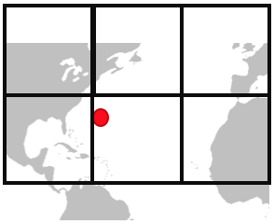
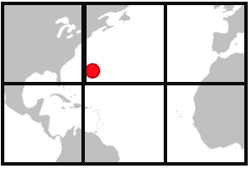
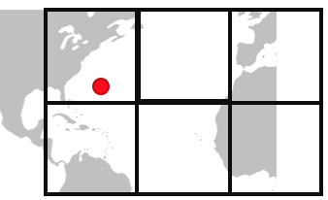
Approach 1. Detection and Localization
Stage 1: Data Collection + Labeling
Stage 2: Detection
Stage 3: Localization
Crop by grids
Hurricane
x’ (longitude)
y’ (latitude)
…
Temperature
(x’₁,y’₁)
precipitation
:
Convolutional Neural Network
Where is the hurricane? (Regression)
(x,y)
wind
(x’₂,y’₂)
Yes
:
No
…
Climate data
Normal
Labeled by historical record
Convolutional Neural Network
Does it contain hurricane? (Classification)
Yes (x,y’)
No
No
Yes (x,y)
No
No
No
:
Notes:
Now, I would like to describe three approaches to detect and localize extreme climate event.
As the first task, we choose the hurricane as extreme event.
The detection and localization hurricane can be done in 3 stages.
- First, we collect data which came up hurricane in history
Lucky, hurricane have historical record. So, we could collect the labeled hurricane data from the record.
But, If there’s only few historical record of event, we will use few-shot learning techniques or Generative Adversarial network to generate labeled data based on few labeled data.
When we collect the event, we only collect the nearby bounding box.
In my case, I used 20 degree by 20 degree bounding box.
And randomly slide the bounding box several times to sustain “transient invariance”.
-In second stage, those labeled hurricane data will be the input of “detectionCNNs”, and “detection CNNs” learns to detect “yes” or “no” instance.
-In third stage, just for the ”yes” instance, “localization CNNs” learns to detect exact location-such as latitude and longitude-of hurricane.
(Once those two CNNs finishes learning, the input of this whole framework will be global climate data, and the output is detection result with exact location.)

Slide 8
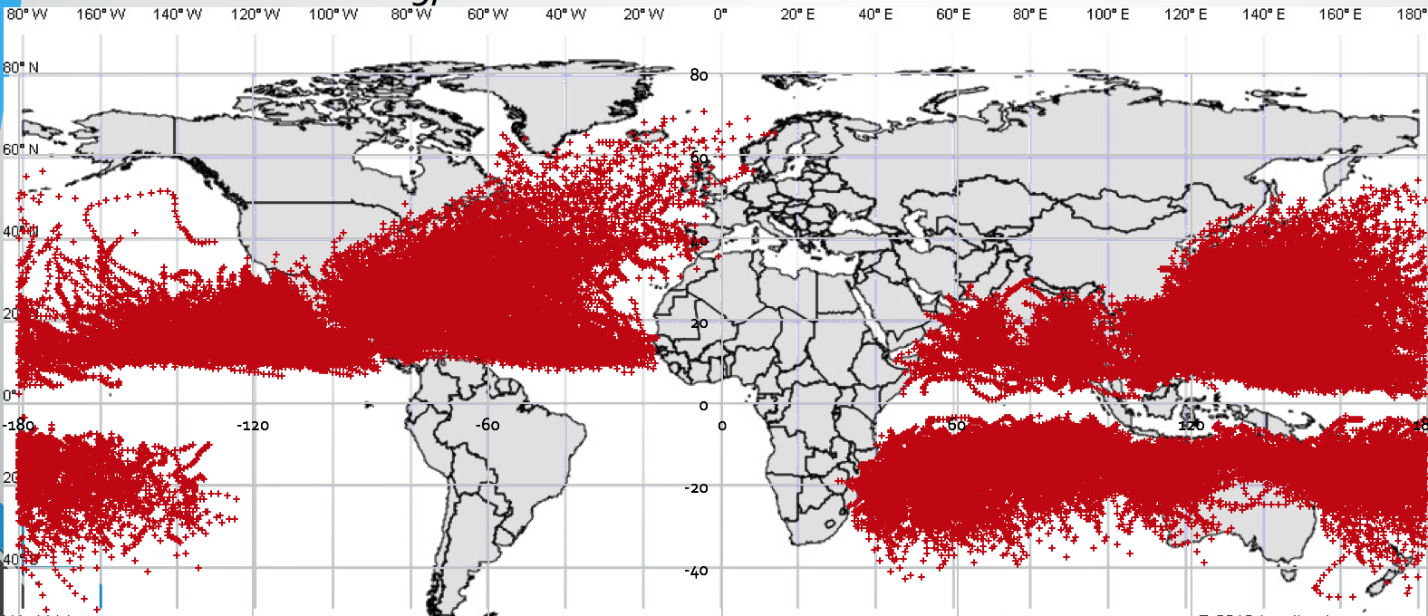
Showcase of Cyclone Detection
From JWTC historical hurricane report, 1979 ~ 2016
Size of collected grid : 20 longitude by 20 latitude
Size of dataset: 109,281
longitude
latitude
Notes:
In our task, we have used JWTC historical hurricane report.
Those red dots are the location where the hurricane occurred in history.
Then, we collected 20x20 sized grid around hurricane.
The total size of data we collected is around 100,000

Slide 9
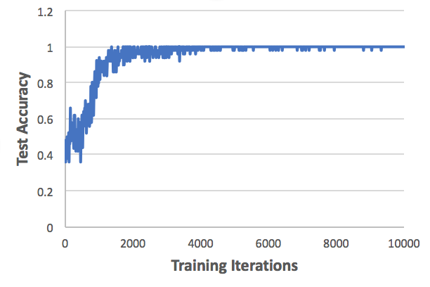
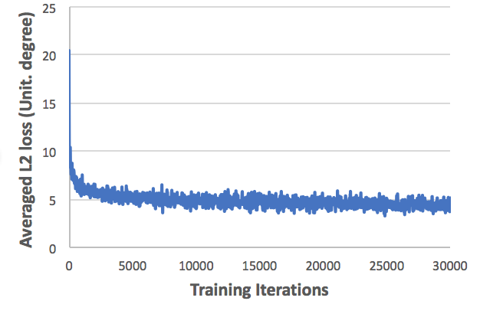
Accuracy
Detection
Localization
Almost 100 % test accuracy for detection
Regression error (L2 loss) is ~ 4 degrees (about 450 km)
Notes:
Here is our main result for the hurricane detection and localization”.
For the detection CNNs, we have achieved almost 100% accuracy using our data.
For the localization CNNs, we have achieved around 4.5 degrees of regression error.
Considering that 1 degree is around 100km, that means CNNs localize hurricane with 450 km off from the true location which is not great.
We consider the reason for this poor localization accuracy is low resolution of data.
Then, how can we increase the localization accuracy without downscaling process?

Slide 10
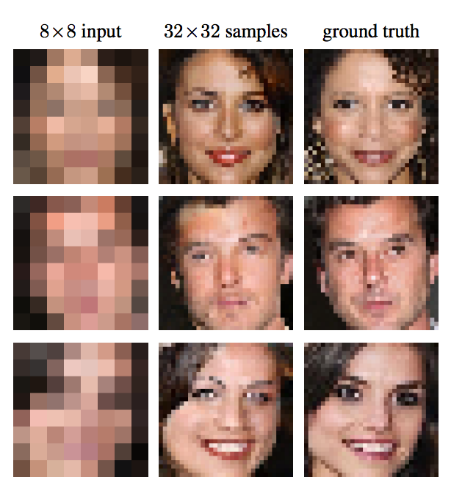
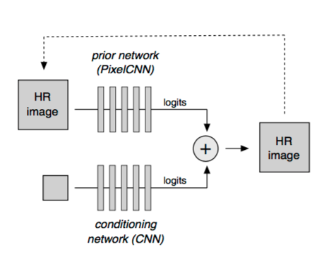
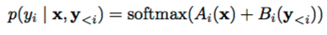

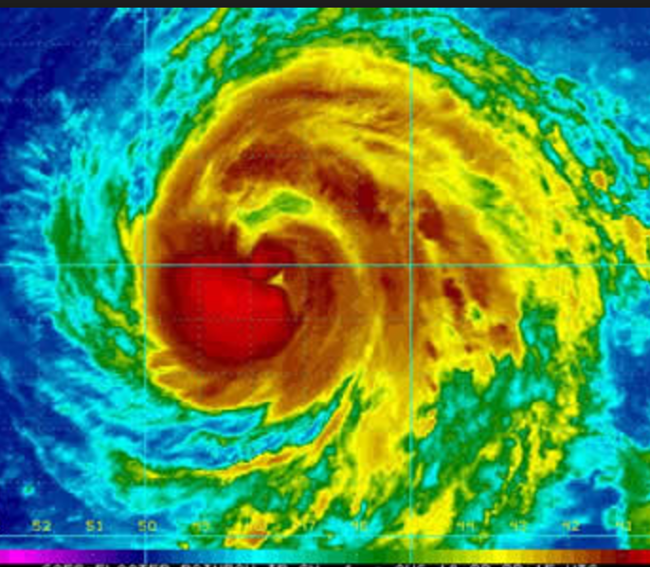
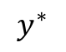
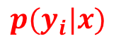
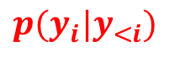
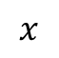
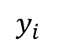
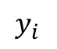
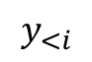
Increase localization accuracy using Pixel Recursive Super Resolution
x
y
y*
Pixel Recursive Super Resolution
$$p(y_{i}|y_{<i})$$
Capture serial dependency of pixel
B
Low resolution image
Reconstructed super resolution image
Ground truth High resolution image
$$y_{<i}$$
$$y_{i}$$
?
$$y^{∗}$$
A
$$p(y_{i}|x)$$
backpropagation
Capture global structure of x
$$y_{i}$$
$$x$$
Dahl, Ryan, Mohammad Norouzi, and Jonathon Shlens. "Pixel recursive super resolution." arXiv preprint arXiv:1702.00783 (2017)

Slide 11


Approach 2. Increase localization accuracy using Pixel Recursive Super Resolution
Low resolution image
Reconstructed super resolution image
Ground truth High resolution image
Dahl, Ryan, Mohammad Norouzi, and Jonathon Shlens. "Pixel recursive super resolution." arXiv preprint arXiv:1702.00783 (2017)
Notes:
Here is our approach to increase localization accuracy.
How about increase resolution not by downscaling but by pixel recursive techniques using DL?
Pixel recursive super resolution is recent method developed in google research this year, which is reconstructing hr img from lr img by making use of prior DL network that conditioning previous pixels to predict each pixels.
And, proved that it work well in reconstructing people’s face.
This is ground truth, this is lr img, and this is reconstructed image.
We can see that reconstructed image is very similar with ground truth, evenif we cannot distinguish any information from lr img.
I applied this technique for climate data, and this is our very recent result .
I generated lr data with color linear interpolation, and reconstructed img. This greenish part is the hurricane center.
Even if we cannot distinguish hurricane center in lr data, this reconstructed data is almost similar or same with ground truch and clearly distinguishable.
Therefore, if we reconstruct hr climate data with lr climate data, we can increase localization accuracy a lot.
This approach is still on going and still running in our cluster at this point..

Slide 12
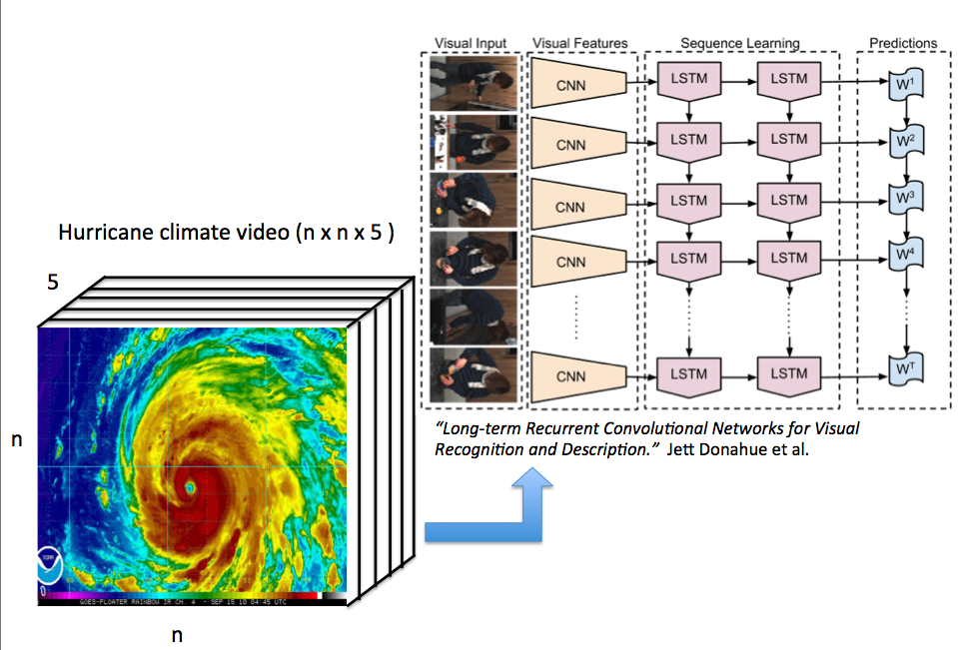
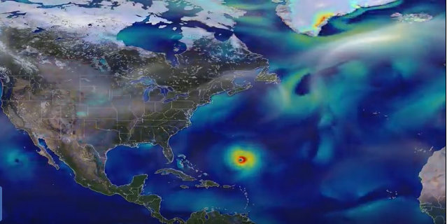
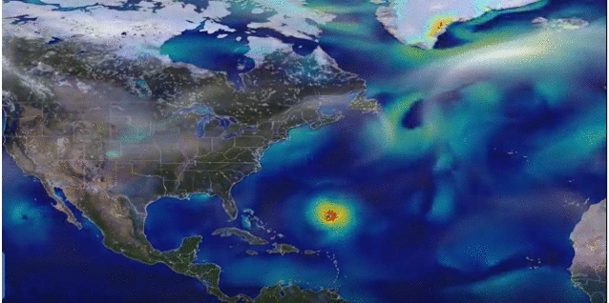
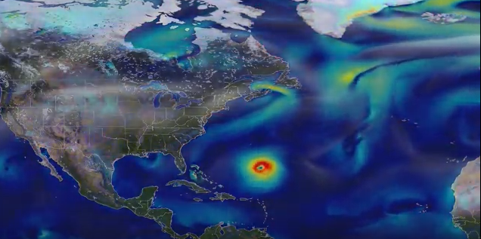
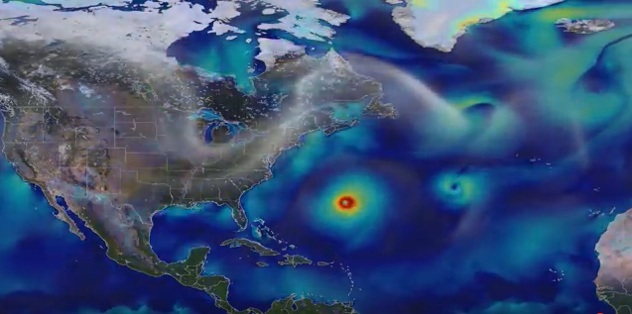
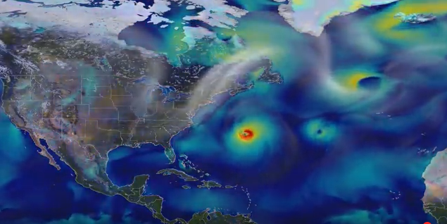
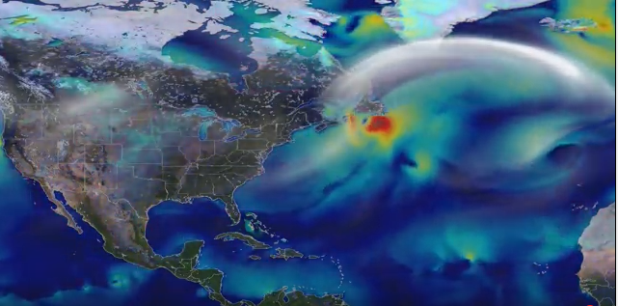
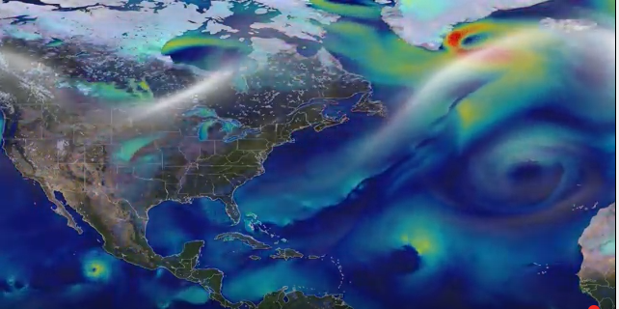
Approach 3. Action Detection
Input
Feature
Time Sequenced Learning
Prediction
pooling
Yes/ No
Time-Series of Re-analysis Climate Data ( Climate Video )
time
Long Term Recurrent Convolutional Network for Climate Action Recognition and Description
Notes:
The another project in our mind is to detect time evolution of climate event using LSTM (Long Short Term Memory).
This is the analogy of action detection of multimedia video.
First, we should collect time-sequenced climate data, and it can be described as the climate video.
Then, we divide each frame of video, and it plugged as input of CNNs.
Time-sequenced feature of each CNNs will be the input of LSTM, and output of LSTM will be pulled later on to decide whether the given climate video contain hurricane or not.

Slide 13
Summary
Deep Learning save computing power and human effort
Analyzing learned latent features → Scientific research ,Future model development.
Implementing Deep Learning Framework in ESGF → BER projects, the Geoscience communities.
Speed up the geoscientific event discovery processes
Notes:
So far, I have described key concept of DL techniques and its potentials for geoscientific and climate community.
To sum up, DL is the real game changer and has tremendous potentials to give us benefic.
As I mentioned, DL based climate event detection will save computing power and human effort.
Also, by analyzing learned latent pattern in CNNs, we can get the valuable resources for scientific discovery and model development.
Therefore, implementing DL framework in ESGF will be great benefit for BER project and also the geoscience community.
And, ultimately speed up the geoscientific event discovery process.
Thank you for your attention.

